Slide 1

Movie
Recommendation System
BY:
1. Elsie Juma
2. Iain Mosima
3. Ibrahim Hafiz
4. Elsie Kiprop
5. Davis Obatsa
6. Peter Kigoth
7. Oscar Karuga

Slide 2
Objectives
Business Understanding
Data Understanding
Key findings
Methods
Results
Recommendations
Conclusion

Slide 3
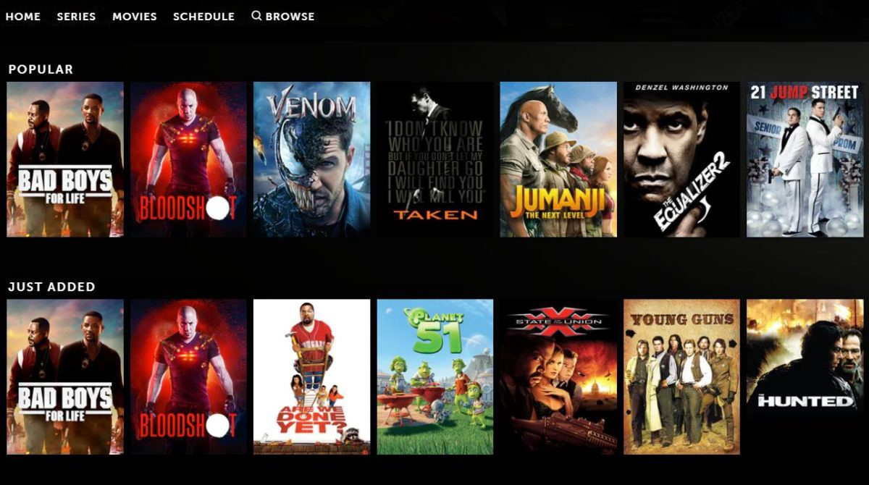
Introduction
A recommendation system refers to a system that is capable of predicting the future preference for a set of items for a user.

Slide 4






Business Understanding
Cinemy is an upcoming movie streaming platform in the tech world.
Despite having a massive database of movies, user satisfaction is not met.
Most users complained that they found it tough to choose a movie to watch.
To cushion this problem, they hired us to build a recommender system for their streaming platform.

Slide 5


Data Understanding
The data used has been sourced from MovieLens dataset from the GroupLens research lab at the University of Minnesota.
It contains 100836 ratings and 3683 tag applications across 9742 movies. These data were created by 610 users.
100,836 total movies rated
610
users
9724
movies

Slide 6
Key Findings

Slide 7
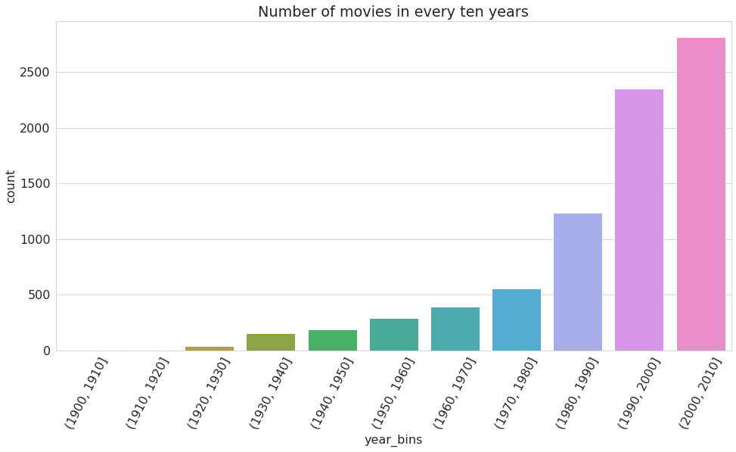
Number of movies per decade
From the graph above, the number of movies produced increases over the years. the highest number of movies produced was between 2000 and 2010.

Slide 8
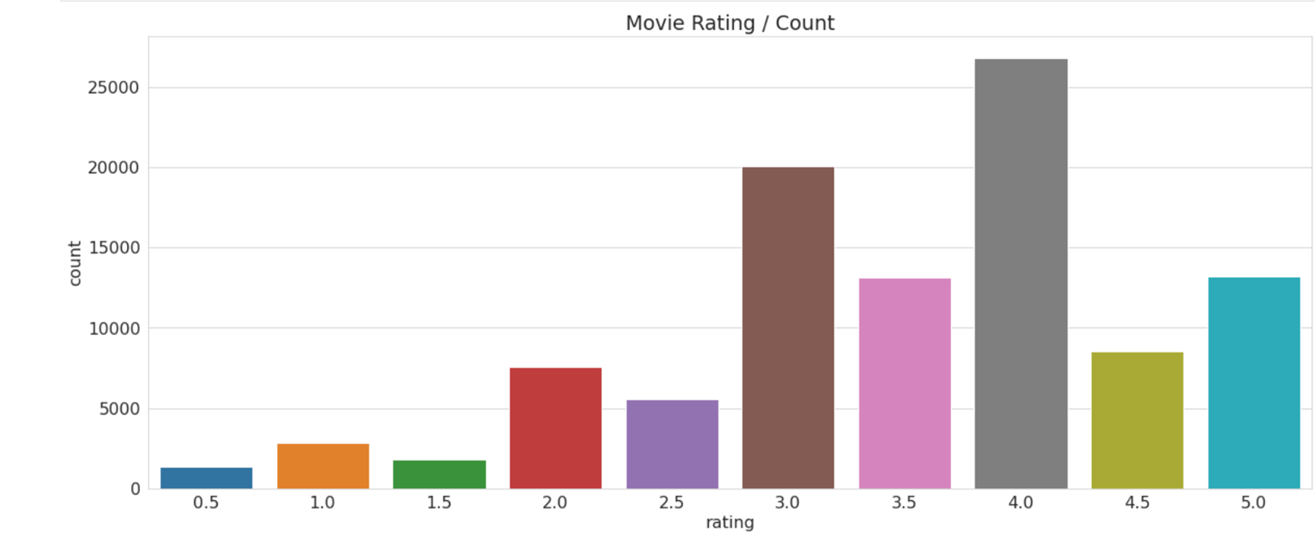
Movie Ratings
Most movies were rated at 4

Slide 9
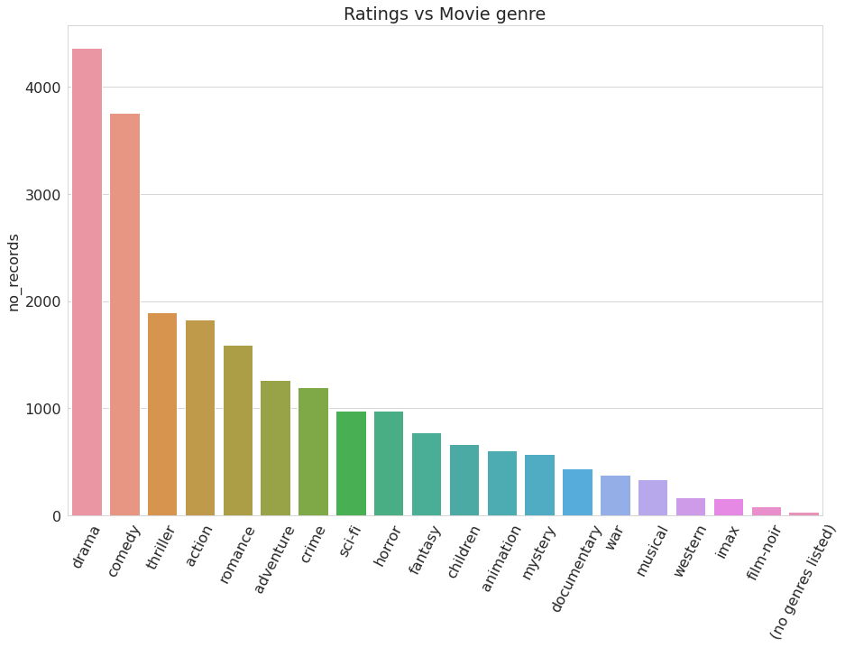
Total movies per genre
Drama was the most frequent genre followed by comedy and the least frequent was flim-noir.

Slide 10
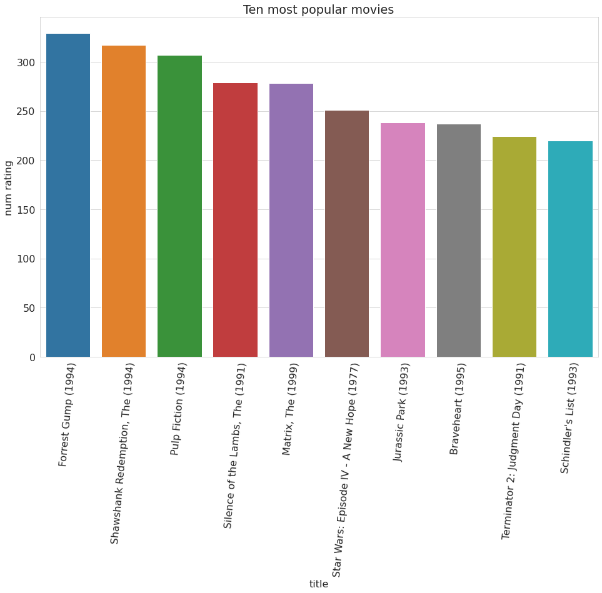
Ten most popular movies
The most popular movie from the above plot is Forrest Gump(1994) with 329 ratings .

Slide 11
Approach
The four main approaches we used were
Naive approach – Recommendation for a new user
Content based – Recommendation based on movie characteristics
Collaborative based – Similar users will like similar movie
Hybrid based – Combination of Naïve approach and collaborative approach

Slide 12






Naive Approach
Movie watched by user
Popular Movies
Recommended to user

Slide 13







Collaborative Filtering
Movies both users have seen
Similar users
Recommended by user to another user

Slide 14
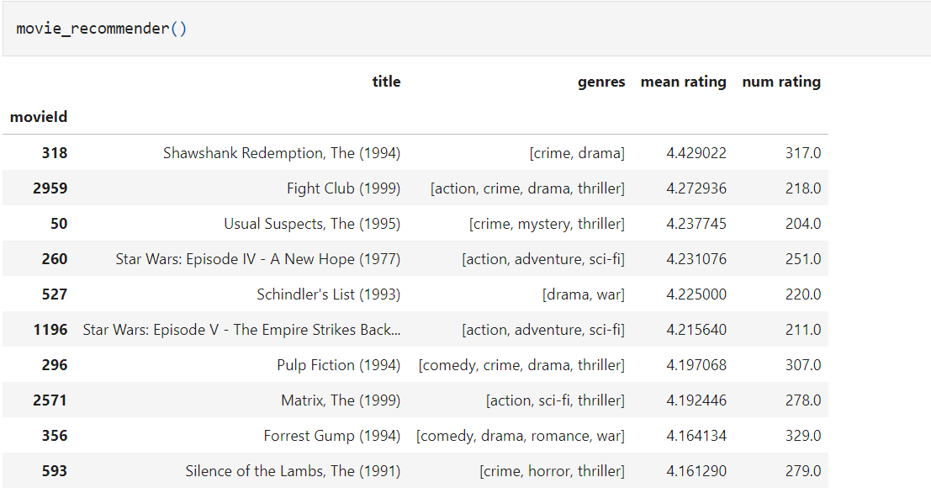
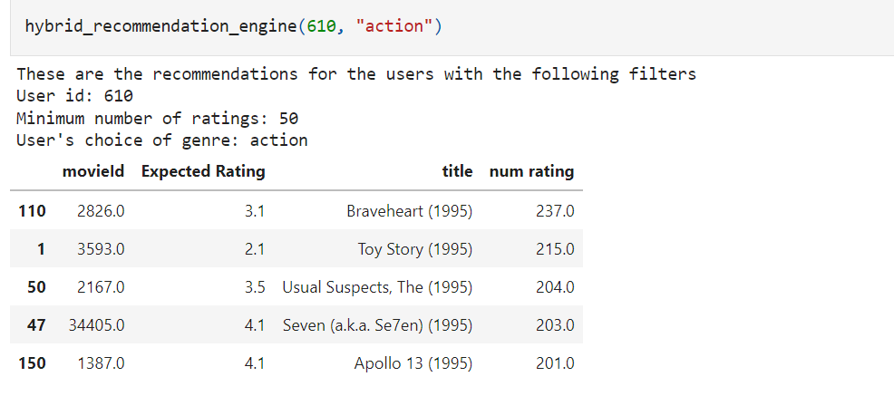
Results

Slide 15



Conclusion
The recommender system works based on previous user patterns.

Slide 16
Recommendations
When a user is new , recommend movies based on their popularity.
For a current user, use their previous information on movie ratings and genres preferred to tailor recommendations.

Slide 17
THANK YOU!
ANY QUESTIONS?

